Slide 1
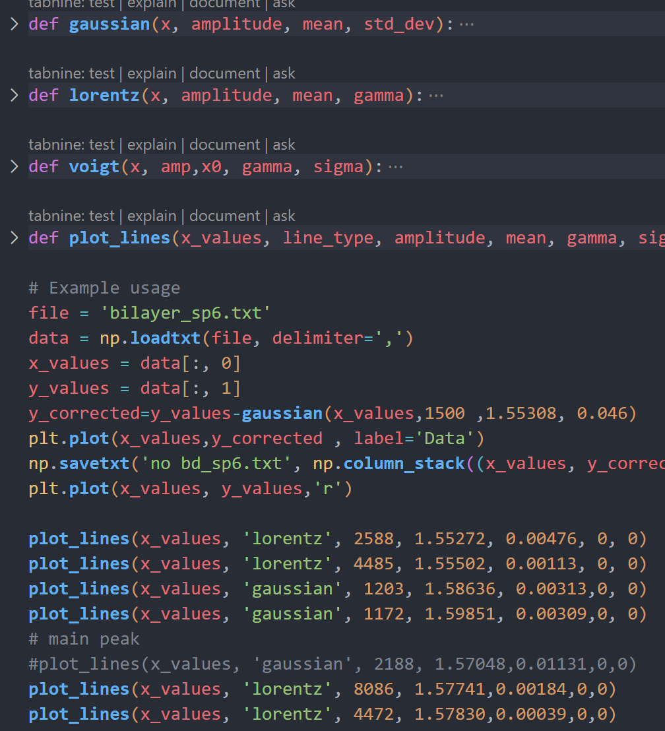
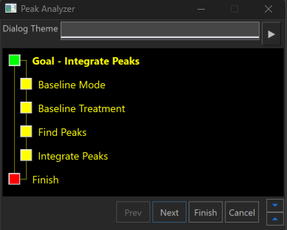
PL Data process (Origin+Python)
Plot original data
Find background & Fit main peaks
(Bg, phonon side band: Gaussian; Main peak: Lorentz)
Minus then fit side band peaks
Draw with Python

Slide 2
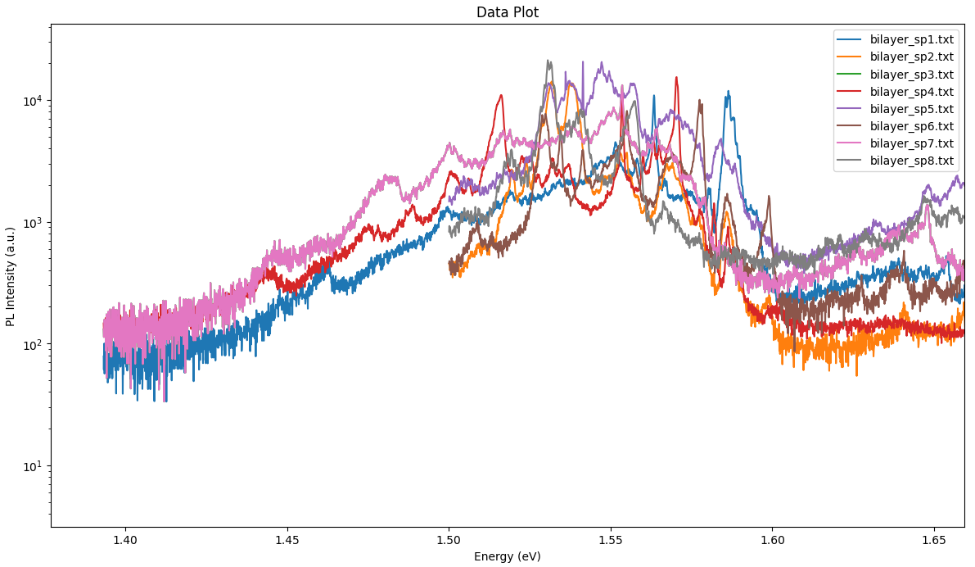
All spots

Slide 3
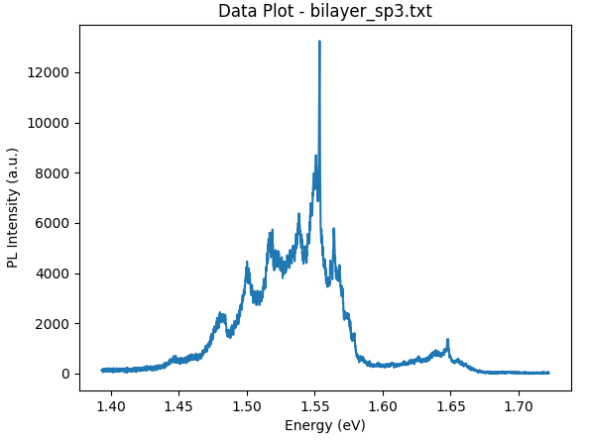
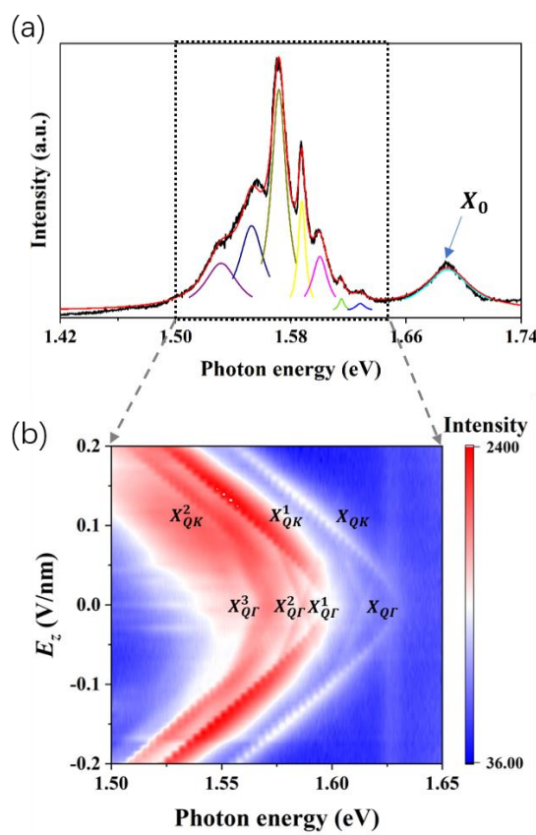
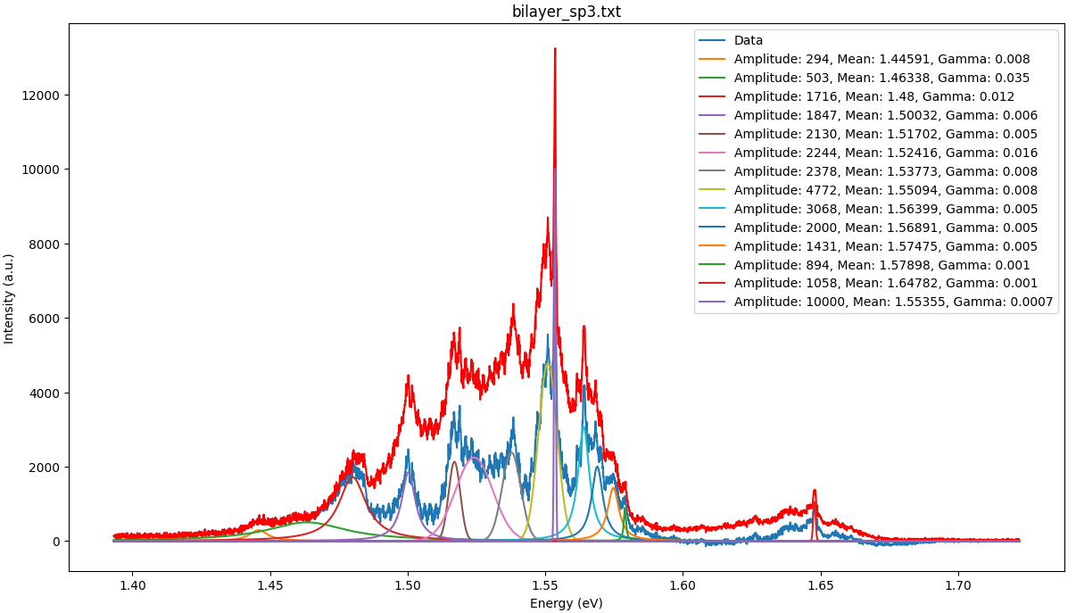
Spot3
PhysRevB.105.L041409
Notes:
Momentum-indirect excitons

Slide 4
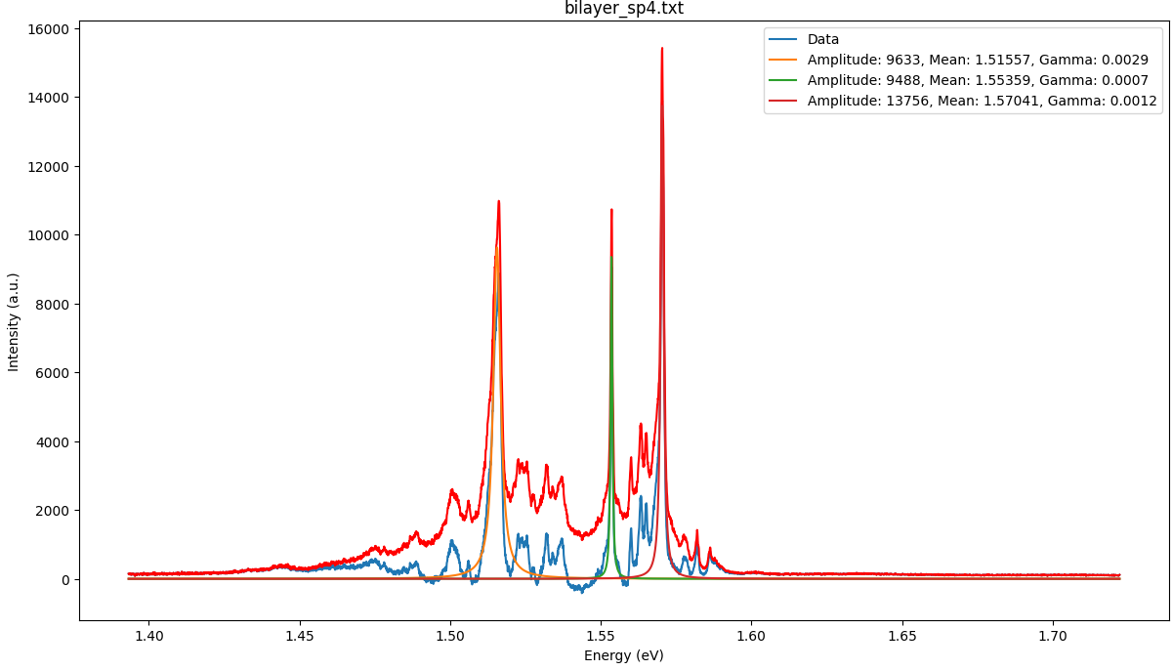
Spot4

Slide 5
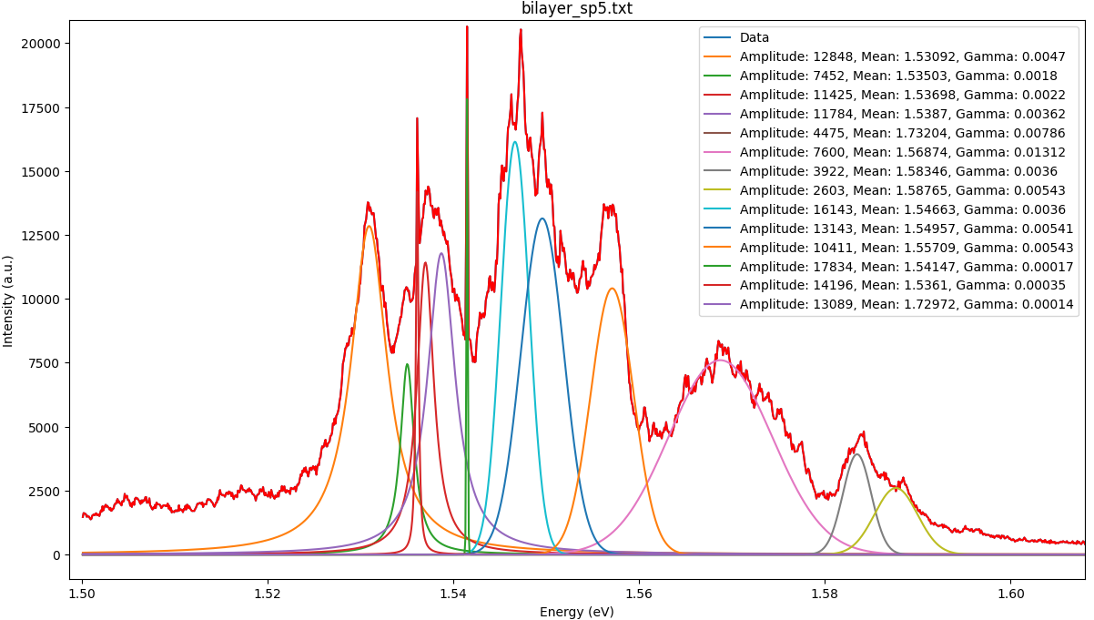
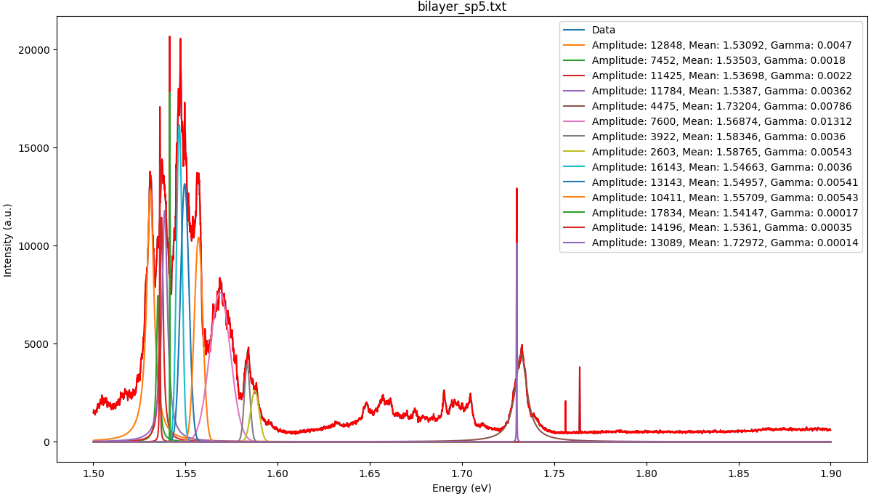
Spot5

Slide 6
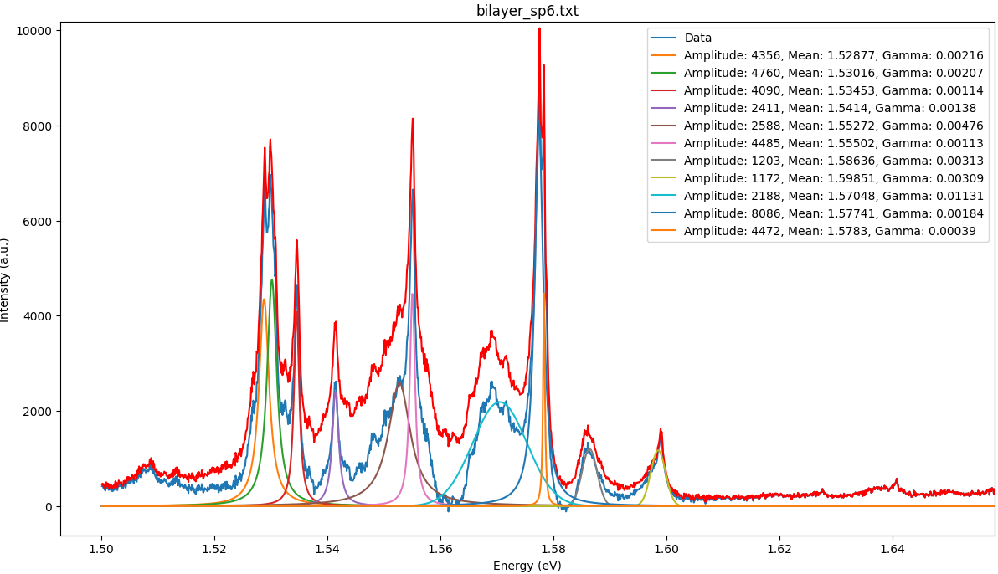
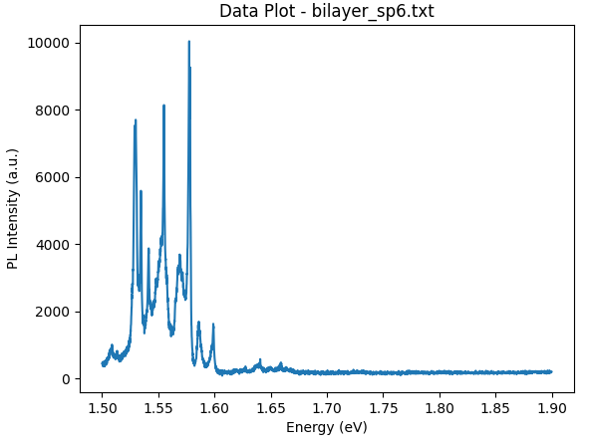
Spot6

Slide 7
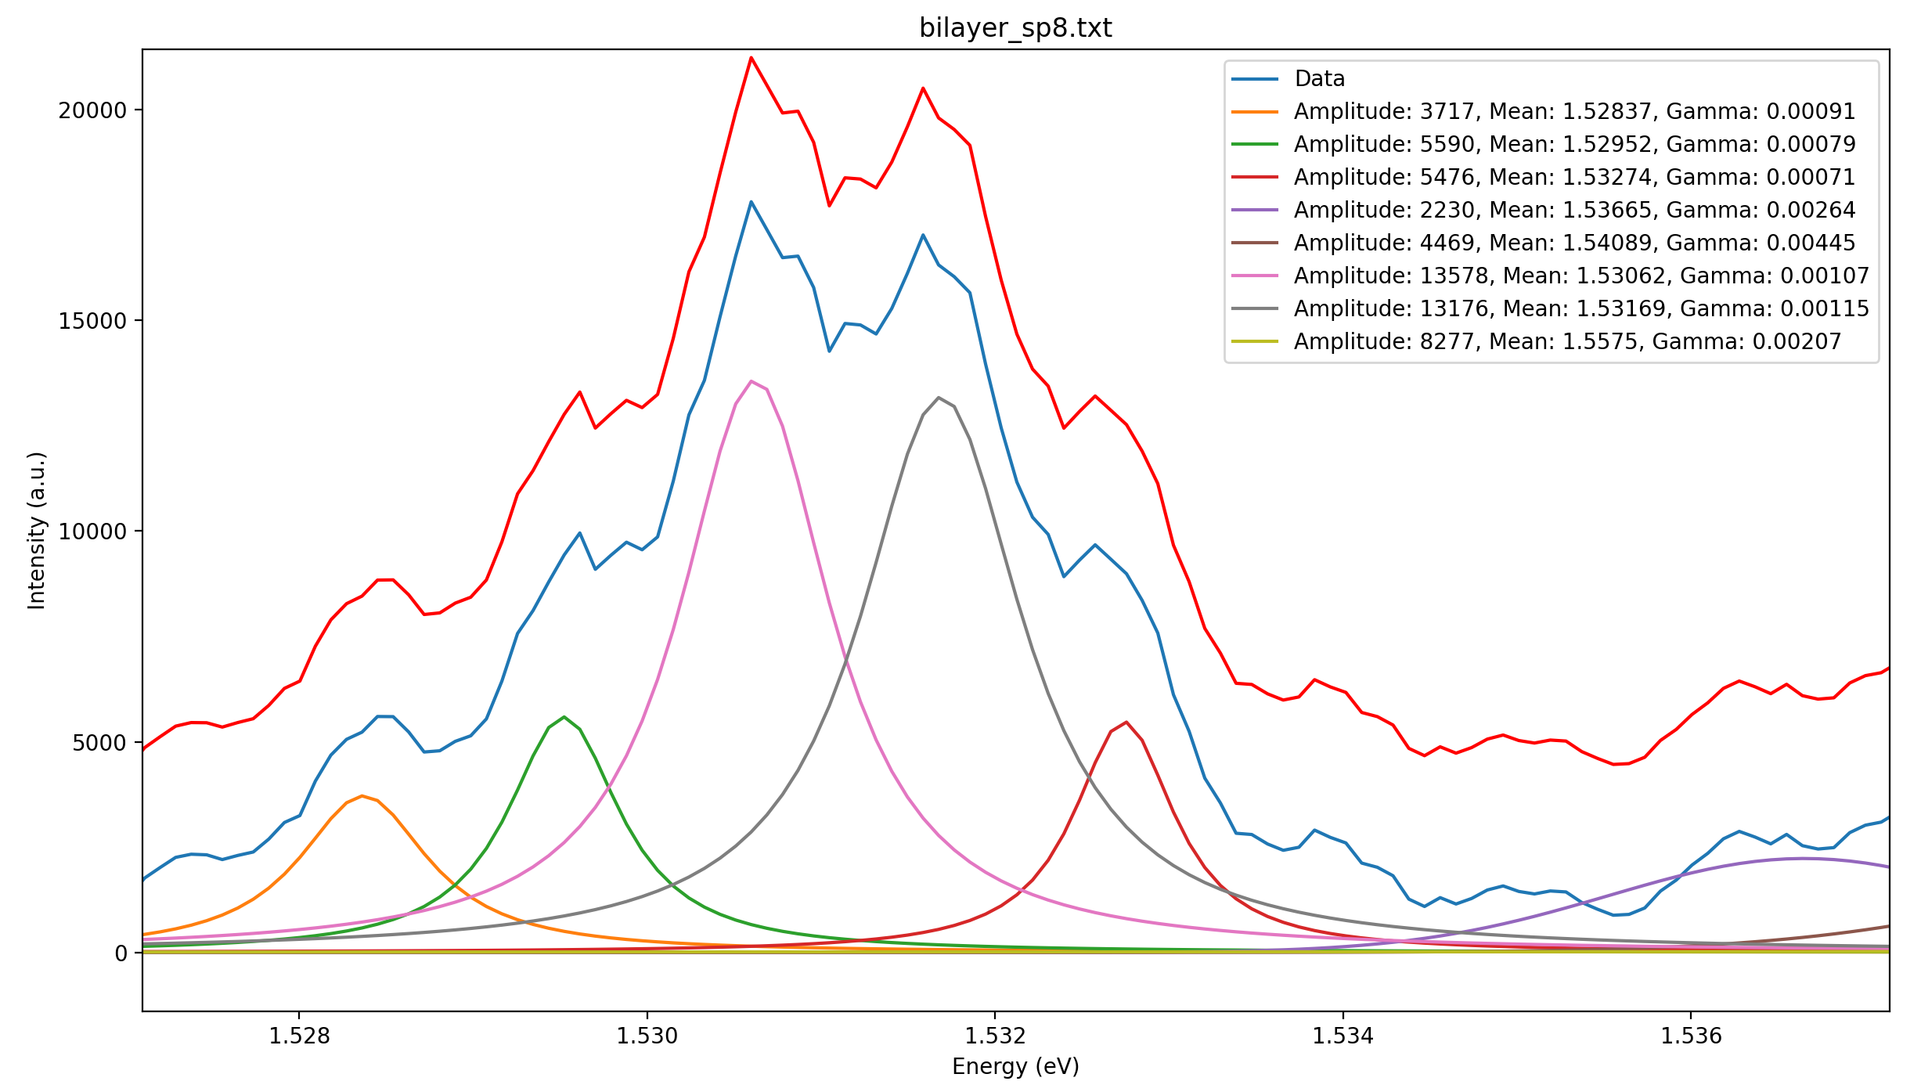
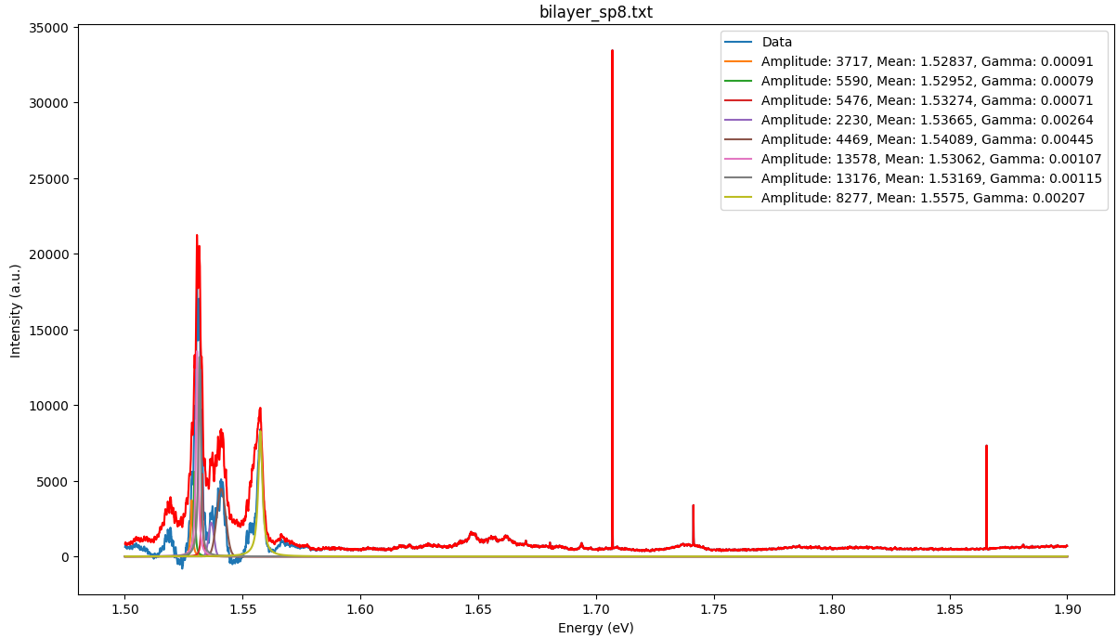
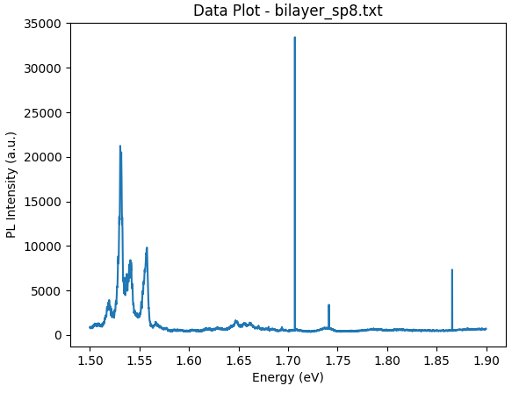
Spot8

Slide 8
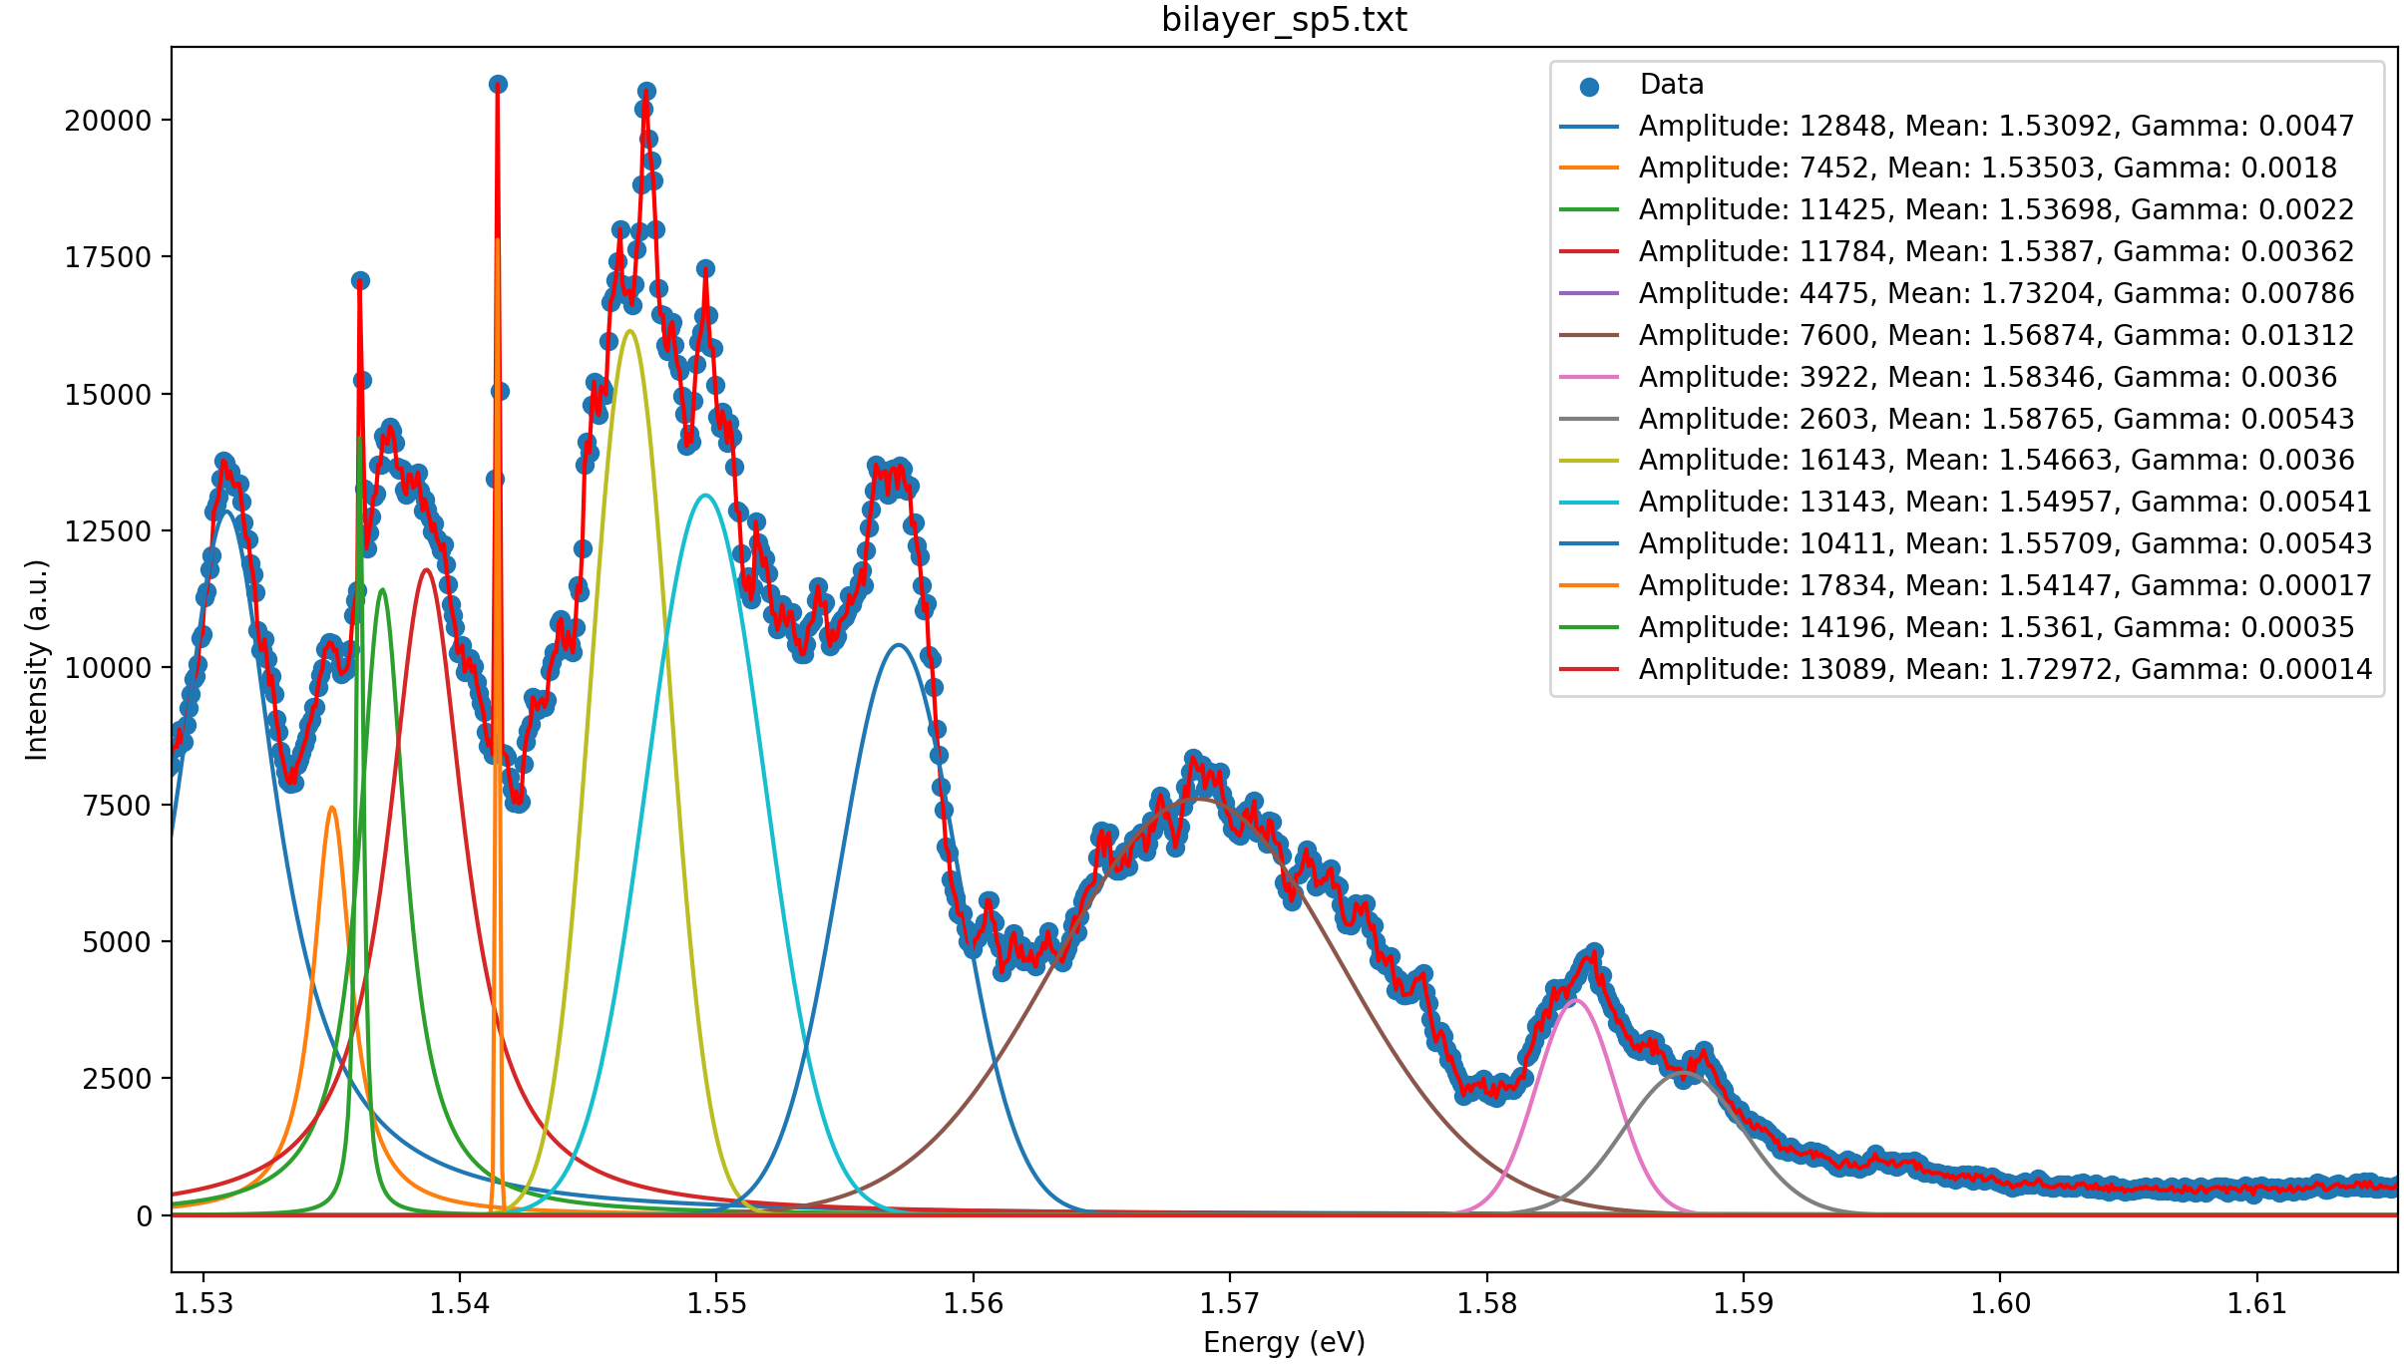
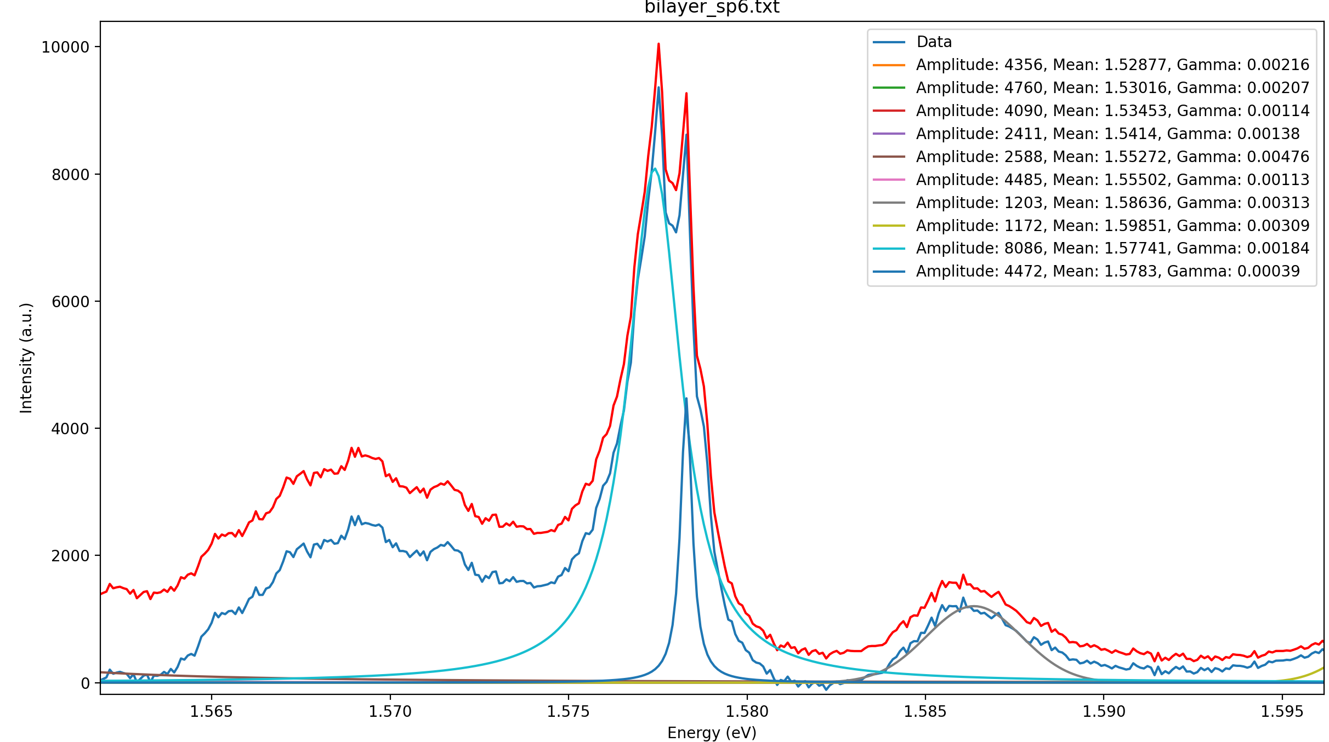
Analyze
Spot | FWHM/meV | Gaussian/meV | Lorentz/meV | Energy dif/meV | Lifetime？/ps
Spot3 | 8.15 | 8.02 | 0.70 | 2.61 | 0.94
Spot5 | 6.27 | 5.41 | 3.60(0.14) | 2.94 | 4.70
Spot6 | 5.31 | 4.76 | 1.13(0.39) | 2.30 | 1.71
Spot8 | 4.35 | 3.80 | 2.07(0.71) | 2.54 | 0.93
FWHM: Total emission linewidth
Lorentz: ZPL linewidth Gaussian: PSB linewidth
Energy difference: ZPL and PSB (Fig1)
Energy difference between main peaks?: 0.9meV (Fig2)
Notes:
phonon replicas due to the coupling between a single IX and a single-phonon mode that are colocalized in the QE
Do we add some Gate voltage?

Slide 9
All spots

Slide 10
Spot3

Slide 11
Spot4

Slide 12
Spot5

Slide 13
Spot6

Slide 14
Spot8

Slide 15
Analyze
Spot | FWHM/meV | Gaussian/meV | Lorentz/meV | Energy dif/meV | Lifetime/ps
Spot3 | 8.15 | 8.02 | 0.70 | 2.61 | 0.94
Spot5 | 6.27 | 5.41 | 3.60(0.14) | 2.94 | 4.70
Spot6 | 5.31 | 4.76 | 1.13(0.39) | 2.30 | 1.71
Spot8 | 4.35 | 3.80 | 2.07(0.71) | 2.54 | 0.93
FWHM: Total emission linewidth
Lorentz: ZPL linewidth Gaussian: PSB linewidth
Energy difference: ZPL and PSB (Fig1)
Energy difference between main peaks?: 0.9meV (Fig2)
Notes:
phonon replicas due to the coupling between a single IX and a single-phonon mode that are colocalized in the QE
Do we add some Gate voltage?

Slide 16
Less integration time--- suppress inhomogeneous contributions to PL
3 kinds of peaks and their side bands--- 2main(0.9meV), 1Gaussian bigger/smaller(2-3meV)
Momentum-indirect excitons? Defect-bound exciton peak? (for WSe2 3-5meV)
Need higher resolution of spectrometer?
https://doi.org/10.1039/C9NR02175B
Notes:
The photoluminescence (PL) linewidth observed for exciton emission is a crucial indicator of material quality, and reflects intrinsic contributions from the radiative lifetime and dephasing from exciton-phonon interactions, as well as extrinsic inhomogeneous broadening effects from factors such as defects and substrate-induced disorder.

Slide 17
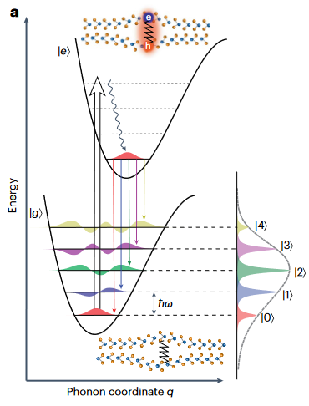
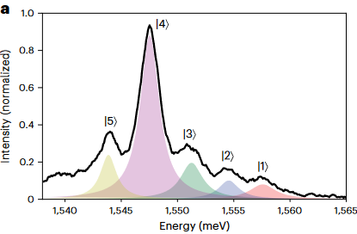
Explanation
The ground state of the QE and its excited state when an IX is generated can be modelled with two potential energy surfaces.
At low temperatures, the QE at the ground-state PES has nearly zero phonon occupancy. When an exciton is created by the pump laser, the QE is excited into a higher-energy PES and quickly relaxes to its zero phonon level.
Upon exciton recombination, the QE emits a single photon and relaxes to its ground-state PES but at an elevated phonon state.
As a result, the energy of the emitted photon is Stokes-shifted from the zero-phonon line, forming phonon replicas spaced by the phonon energy.
https://doi.org/10.1038/s41565-023-01410-6
Notes:
Lifetime of BM phonon instead of photons

Slide 19
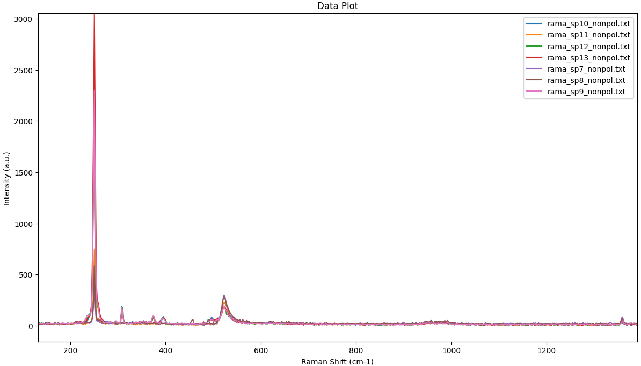
Raman
Main: $E_{2g}^{1}/A_{g}$ Side band:2LA(M)
309${cm}^{−1}$: $B_{2g}^{1}$ 375${cm}^{−1}$: $E_{g}+LA(M)$
395${cm}^{−1}$: 3LA(M) 520${cm}^{−1}$: Si substrate 1370${cm}^{−1}$: hBN $E_{2g}$

Slide 20
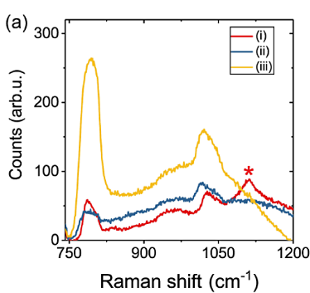
960${cm}^{−1}$ peak?
https://doi.org/10.1021/acsphotonics.4c00349
Notes:
磷酸盐960-970

Slide 21
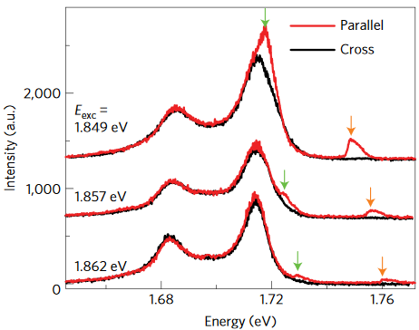
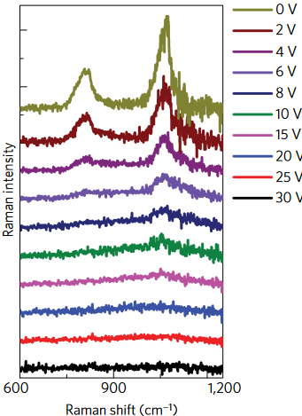
The vibration modes of the hBN lattice can modulate the behavior of electrons and holes in WSe2 thus enabling interlayer electron phonon coupling.
New Raman modes from hBN ZO phonon and the combinatorial hBN ZO and WSe2 A1g phonon in WSe2/hBN heterostructures.
Induce Polarization/ Gate voltage as parameters?
Scan <100${cm}^{−1}$ Raman for BM phonons?

