Slide 1
Introduction about some work
Zhongqi Xiu
2024.7.26

Slide 2
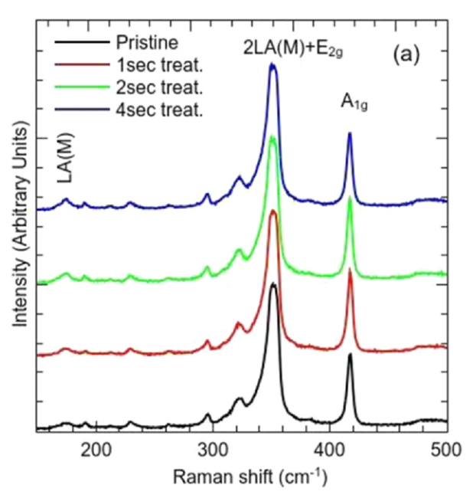
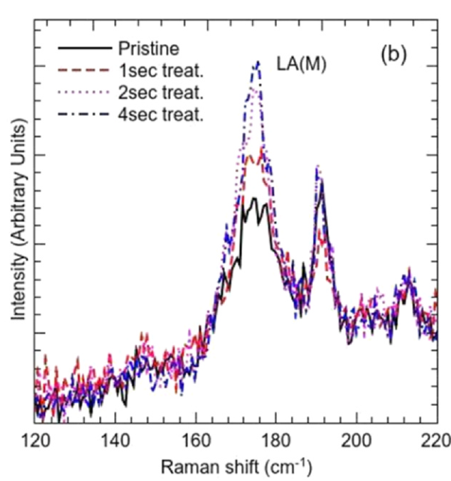
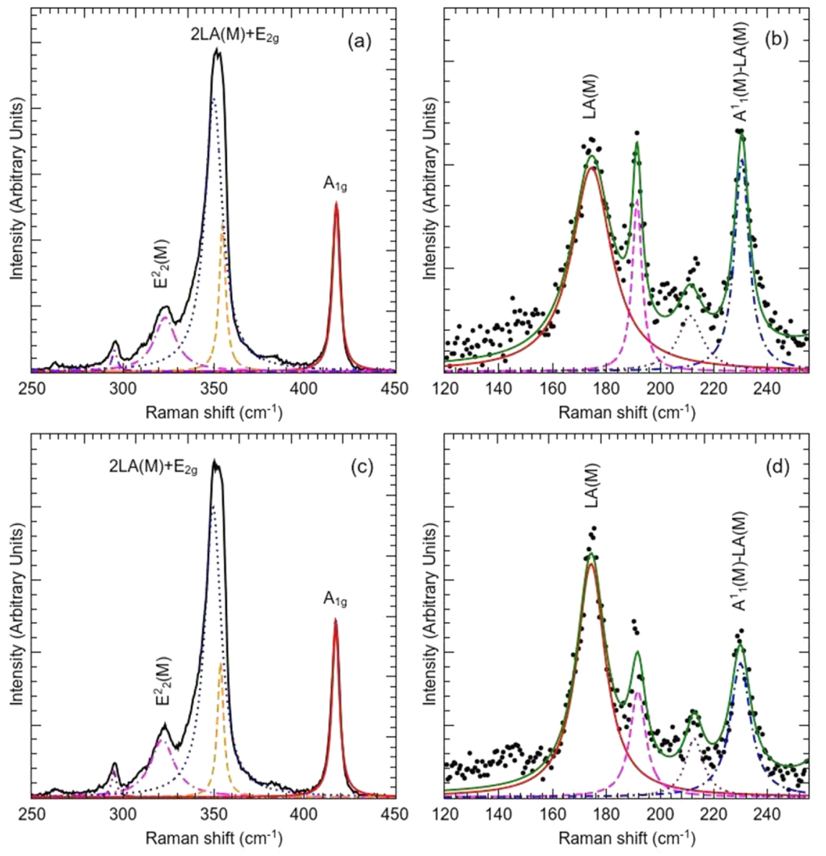
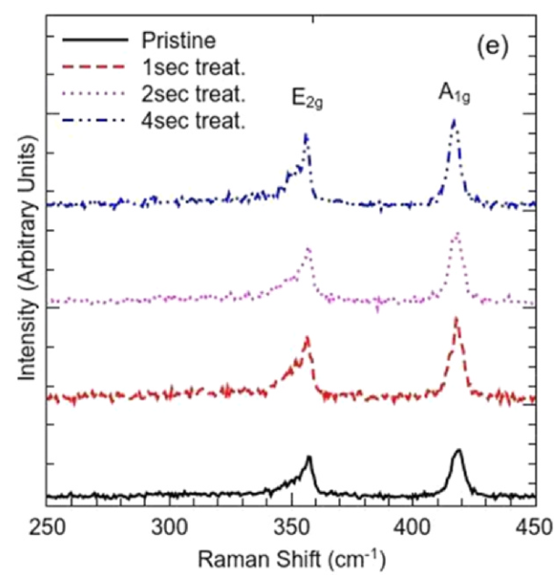
1
Sample preparation : CVD
Plasma treatment : bombard, generate by RF coil, vacuum chamber
Raman(514.5nm, 488nm): LA(M) --- density of defects
$E_{2g}A_{1g}$ redshift --- nitrogen in sample, lattice constants
https://doi.org/10.1016/j.apsusc.2020.147685
Notes:
LA(M) ↑ ---system slowly lose crystallinity after plasma bombardment
strong suppression of the double-resonant 2LA(M) phonon under excitation energy (2.54 eV, 488 nm)
E2g A1g redshift--- lattice constants, band structure and p-doping due to N
near resonance energy close to Xb exciton with absorption peaks at circa 2.4 eV
440 peak?(occur in high defect density) Up2 pristine down2 4s treat

Slide 3
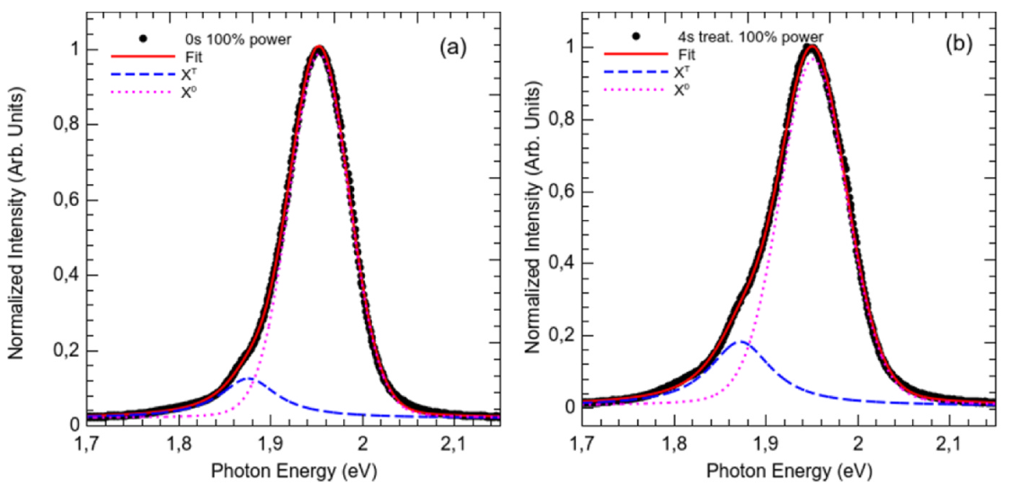
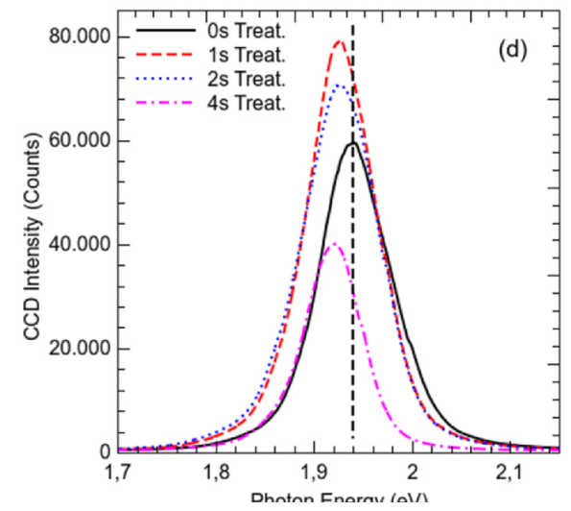
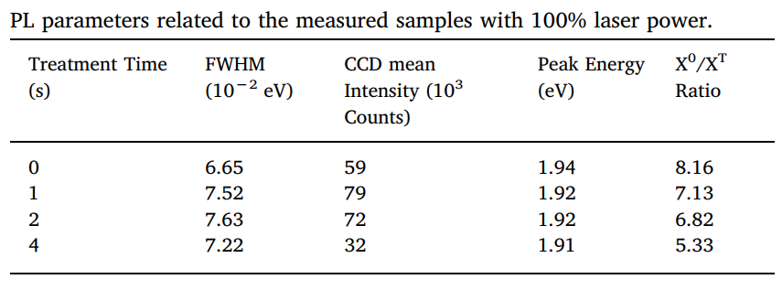
PL(473nm, 1μm spot, 2-0.02mW)
PL from recombination of electron–hole pairs is not strongly red-shifted---band structure not radically affected
Micro redshift originates due to the inclusion of discrete defect states inside the bandgap.
Normalized by the intensity of the first-order Raman Si peak
Notes:
PL : recombination of electrons in the conduction band with holes in the spin‐orbit split valence bands
Impurity energy levels will form the electronic bandgap, the combination of excited electron-hole pairs will emit photons with smaller energies than pristine samples.

Slide 4
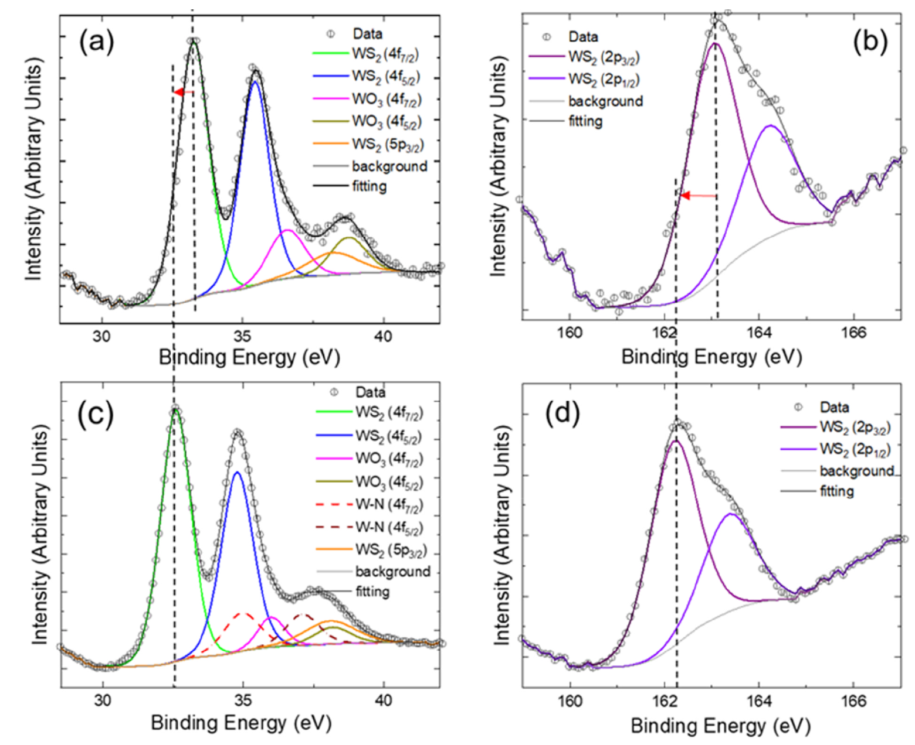
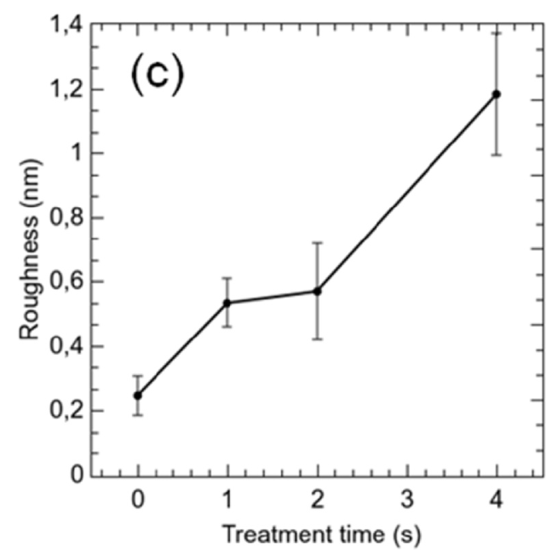
XPS spectra related to core levels of the W4f and S2p
The redshift observed for both S and W peaks after the plasma exposition can be attributed to the substitution of S by N.
The lower luminescence may be related to increase in roughness since the treatment is degrading the monolayers
Notes:
After this time threshold(阈值), longer treatment times, weaker photoluminescence emission of samples
Because of the surface degradation caused by the plasma bombardment, rather than by the incorporation of nitrogen ions in the lattice
Work Sum: PL↑, a redshift of the core level W4f and S2p spectra, as well as a change in the VBM, revealing the p-doping of WS2 monolayers is confirmed by the redshift observed on the Raman spectra.

Slide 5
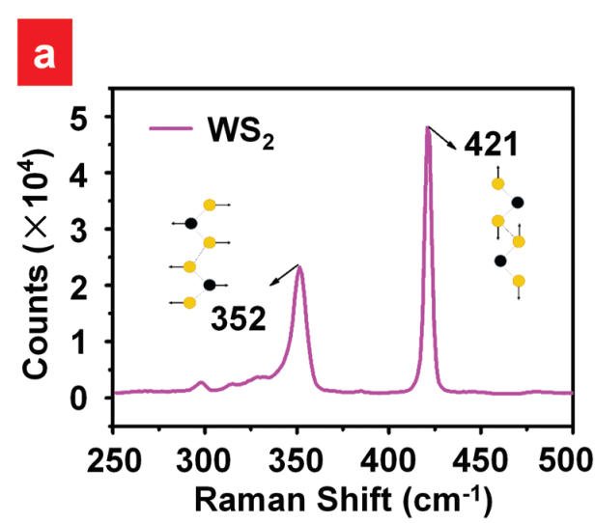
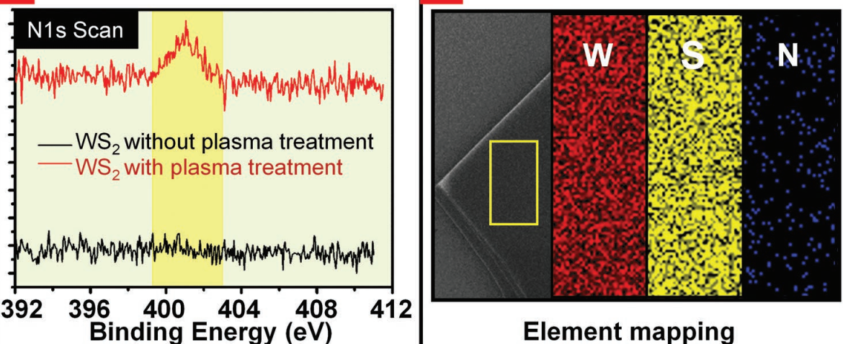
2
Sample preparation : mechanical exfoliation
Plasma treatment : PDC-32G plasma cleaner under a high RF LEVEL for various durations. A mechanical pump was used to evacuate for 10 min; then, nitrogen gas kept flowing for 10 min to stabilize the internal pressure. The power was turned on to record the glow time.
Raman(right): 532nm
XPS(down): N1s peak 401.1eV(pyrrolic-N)
https://doi.org/10.1002/smll.201901791
Notes:
做field-effect transistor电学性质的改善
352peak: E2g 421peak: A1g

Slide 6
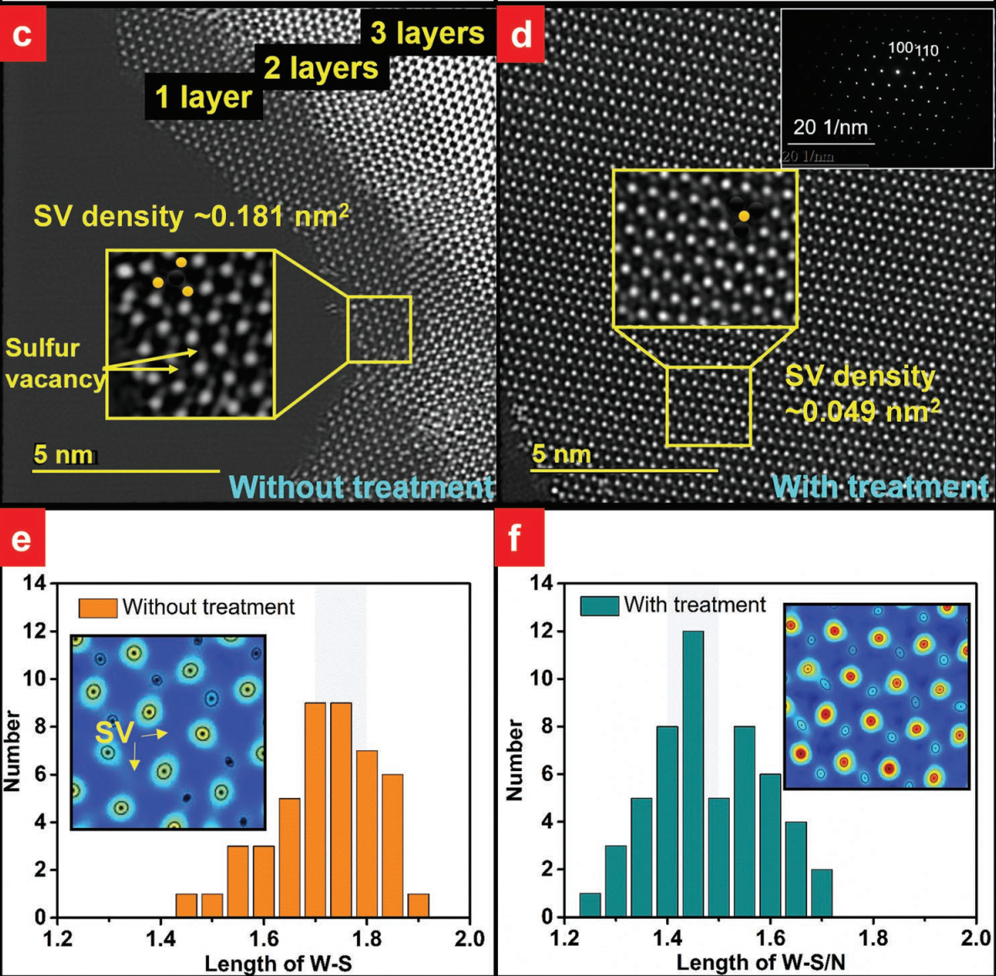
Atomic structures via STEM
After treatment, the vacancy density is lower and the length of W-S/N shorten.
SVs were repaired and adsorbed by N atoms by forming W-N bonds and N doping can reduce the work function of WS2 theoretically.

Slide 7
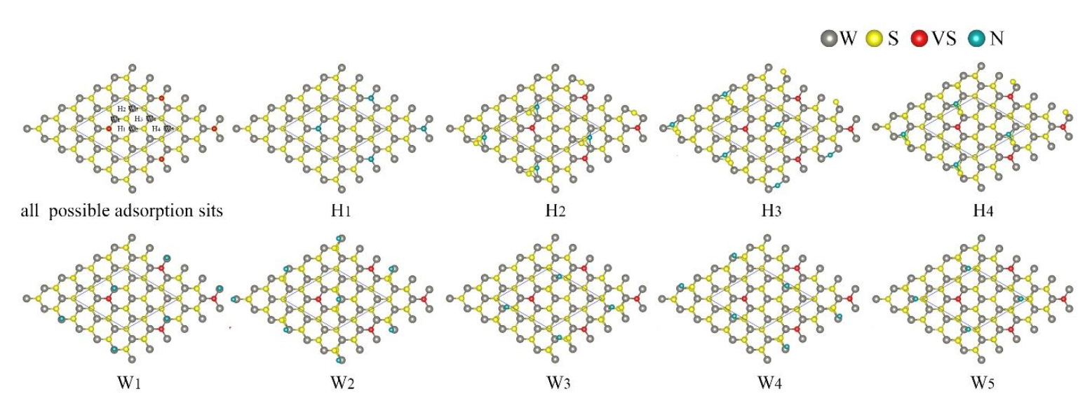
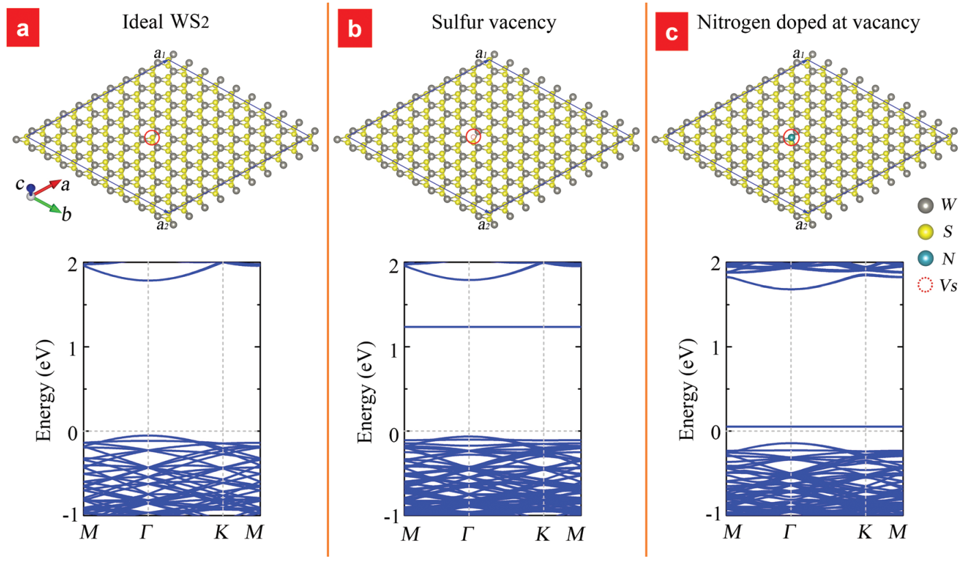
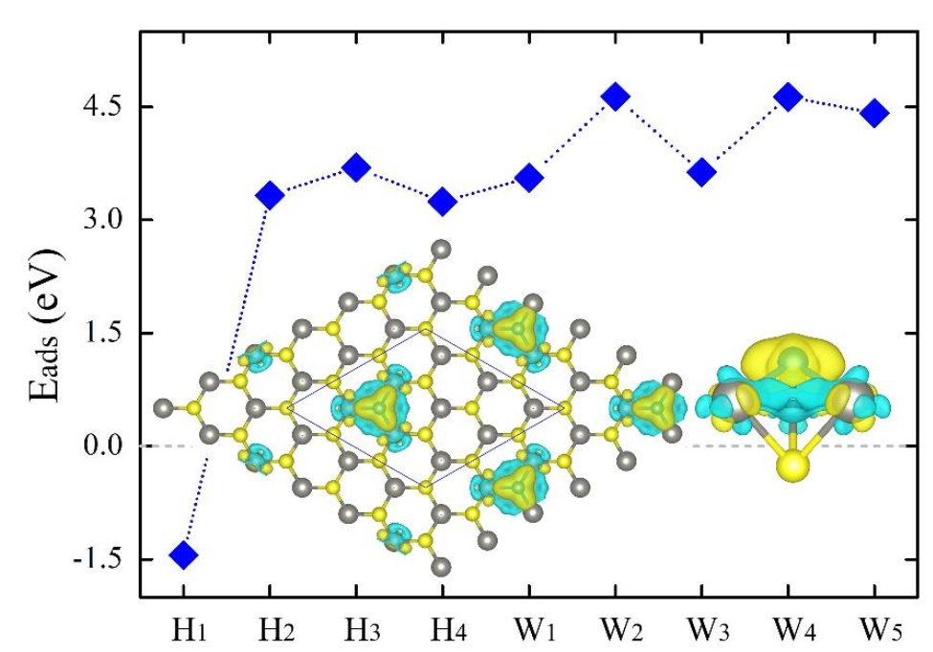
First-principles calculations
Adsorption energies of the sites
Under a critical SV concentration, nitrogen compensation doping can reduce the electron effective mass, which provides an effective way to improve the carrier mobility of WS2
Notes:
the hole sites of the hexagonal honeycomb lattice and the top sites of W atoms
Show that nitrogen will dop into sulfur vacancy.

Slide 8
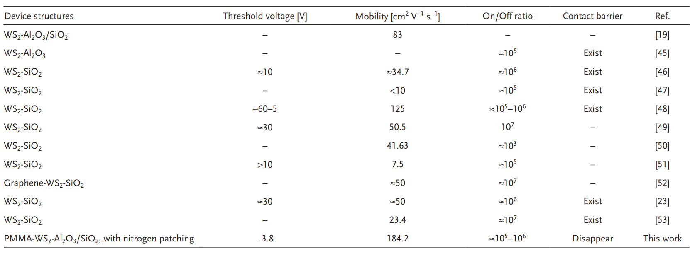
Summary of the FETs in various reports

Slide 9
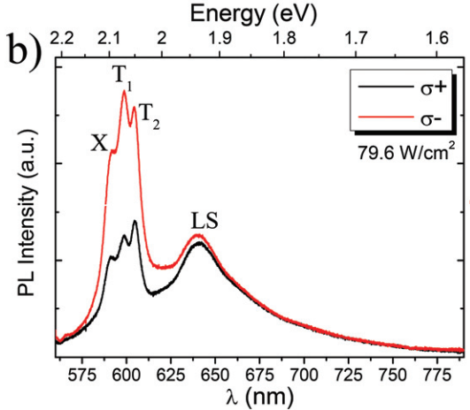
3
591nm/2.10eV X (neutral exciton state)
598nm/2.07eV T1 (low energy trion)
605nm/2.05eV T2 (high energy trion)
640nm/1.94eV LS (donor–acceptor/ localized states)
T1: electrons occupy the lowest energy sub band in conduction band
T2: both electrons are in the upper conduction-band sub-band
Strong emission bands on the lower energy side of the trion emission is because radiative recombination of biexcitons.
https://doi.org/10.1039/C8NR00719E
Notes:
Laser induced doping seems to lead samples to cyclic processes since the exposure of the MLs to air at room temperature after laser doping at low temperature seems to recover the original PL spectrum

Slide 10
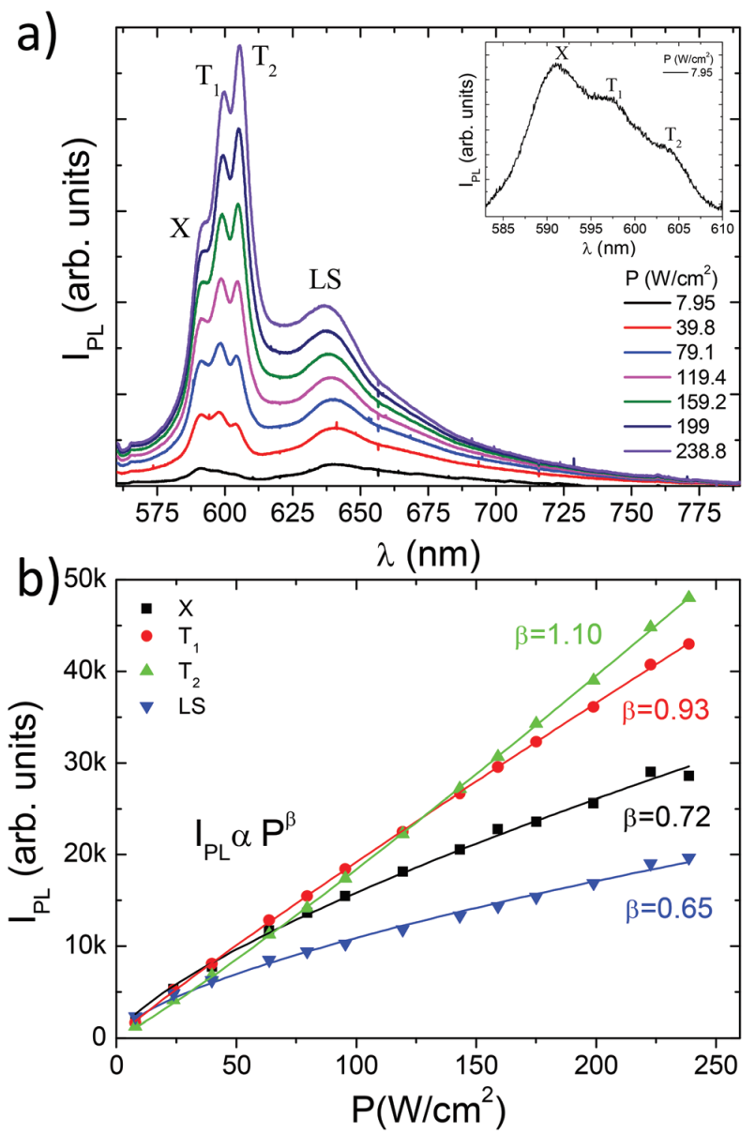
Macro-PL : 532nm excite, T=13K, $σ_{−}$excitation, spot 400 μm
The rise of $T_{2}$ to a dark trion brightening process?
Energy separation between the $T_{1}$ and $T_{2}$ emissions expected for the dark trion process is 2$Δ_{SO}$.
However, given the experimental value of 20 meV, $Δ_{SO}$ value is considerably smaller than the predicted one.
Notes:
The presence of boron nitride(氮化硼) considerably suppresses laser induced doping with carriers injected from the substrate into the TMD ML

Slide 11
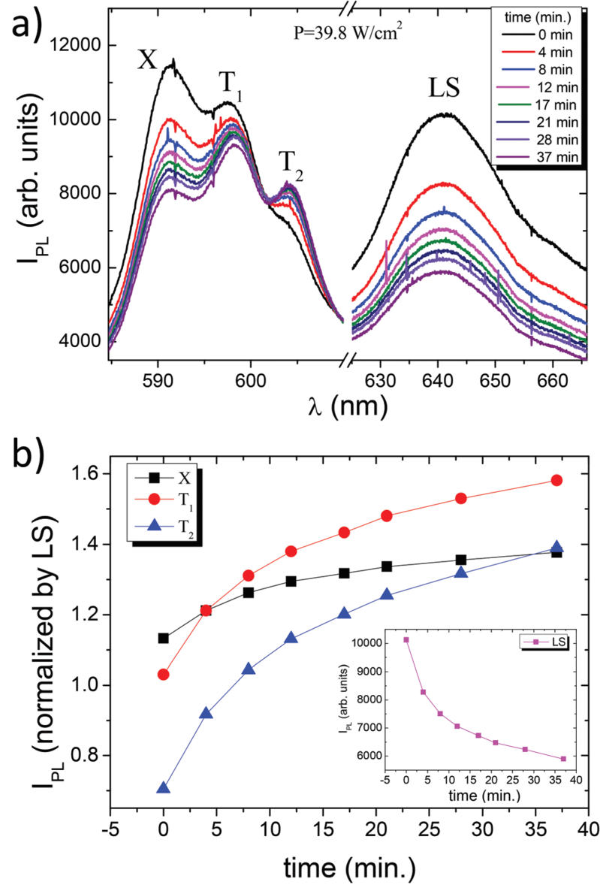
PL with time
The increase of $T_{2}$ emission with time to an enhanced probability that electrons occupy the upper conduction sub band states due to high electron doping induced by laser irradiation.
$T_{1}$ and $T_{2}$emissions increase at very similar rates when electrons are added to the system. This behavior further corroborates our attribution of $T_{2}$ to a trion state rather than a XX one.
As also seen in (b), X emission is more independent of the changes in LS. The absolute decrease in X intensity is attributed to the formation of charged complexes as the system is further doped with increase of time.

Slide 12
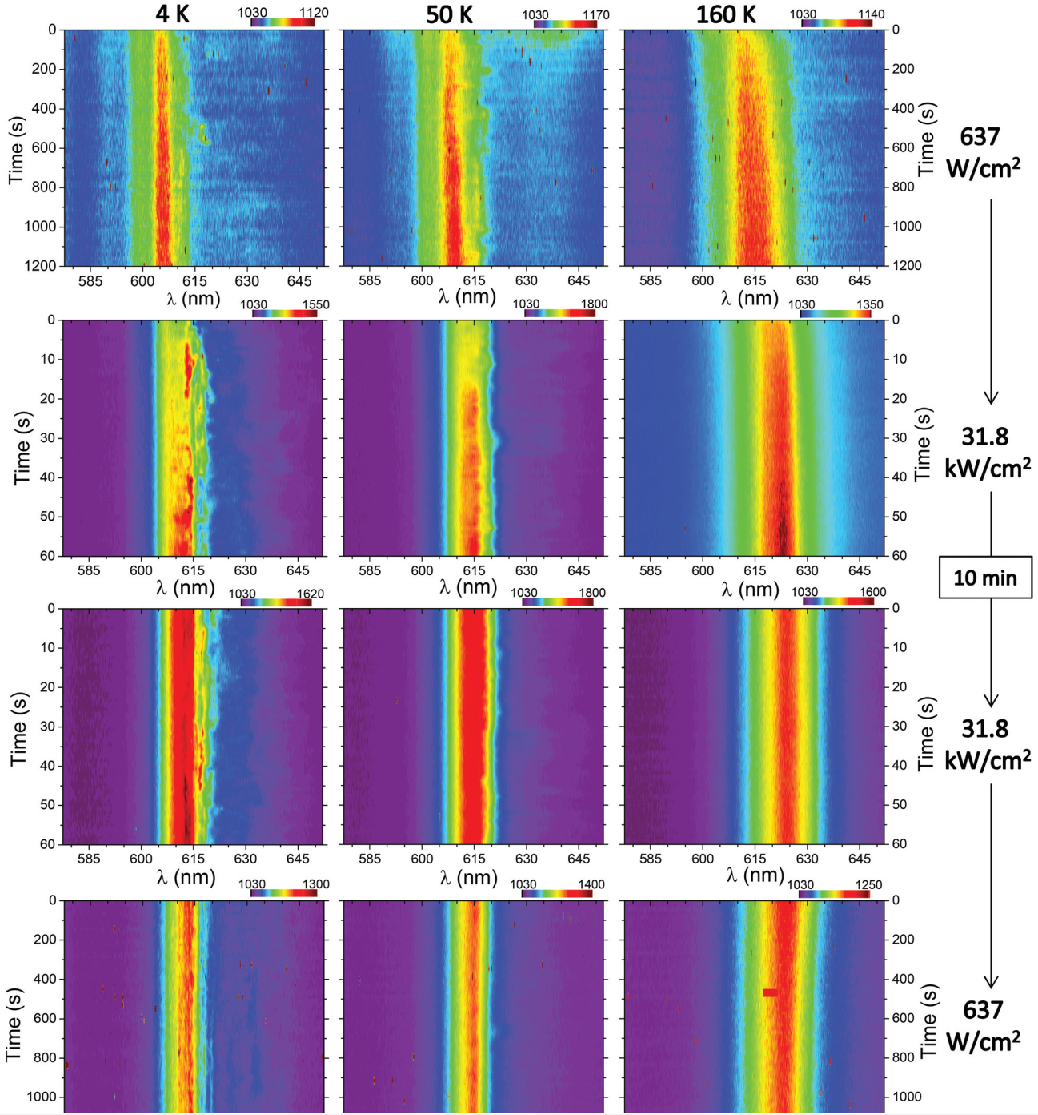
μ-PL spot 2 μm, in vacuum with He cryostat
1. sample is subjected to a laser, then the PL emission is tracked for 20 minutes.
2. power increased and the measurement is performed once more (for 60 seconds).
3. laser incidence is maintained on the sample and after 10 minutes, measurement is repeated.
4. power is decreased and the PL is measured once more during 20 minutes.
Power up---redshift
After 10 mins, slight red shift and signal intensity increase
Power down---no blue shift and intensity bigger than first
Notes:
Laser exposure increases considerably the trion/exciton PL intensity ratio accompanied by a small PL redshift. Laser can reduce emission from localized state band, which is usually attributed to localized/donor–acceptor recombination states.

Slide 13
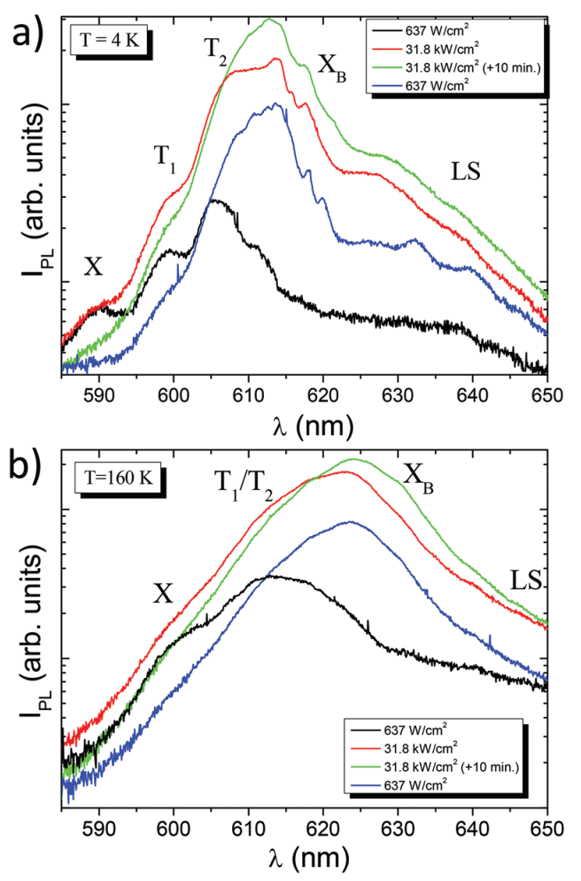
Time integrated μ-PL spectra
(a)Neutral exciton emission is quenched (blue curve), while the spectrum is dominated by $T_{2}$ and $X_{B}$ emissions after laser doping.
(b)160K spectrum is broaden and redshift, and after high power laser, the $X_{B}$ peak will disappear.
And after recover to low power, the spectrum will blueshift
(dominated by a broad emission which superimposes trions trions and $X_{B}$ emission bands).
Notes:
summarizes these experiments by showing the time integrated μ-PL for each view graph of the first column
The process is irreversible and the spectrum maintains its redshift with respect to the initial measurement.
This indicates that elevated temperatures are possibly an important ingredient to revert laser induced doping in these TMD monolayers. However, the time scale seems to be slow enough even at room temperature. The overall behaviour of our sample clearly shows that doping/ undoping of the WS2 monolayer is a very slow process which depends on time and pumping laser power.

Slide 14
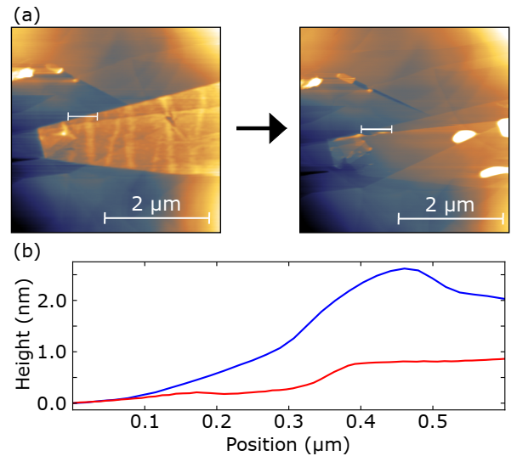
4
Sample preparation : mechanically exfoliated onto Nitto Blue Tapes (Acrylic/PVC) where repeated exfoliation dispersed and thinned the flakes.
The flakes were then exfoliated from the tapes onto pre-prepared PDMS stamps affixed to glass slides where flakes were then assessed for quality using an optical microscope.
Plasma treatment : Samples were prepared in a glass barrelled plasma reactor, which was a QVF process pipe – dimensions 500mm length, 100 mm diameter, clamped between two steel end plates which serve as ground electrodes.
Plasma was ignited using a RFGC-100-13 power generator and automatic matching network , operated at a frequency of 13.56 MHz, connected to a 1 cm thick copper braid wrapped around the glass barrel three times.
Fabrication and Flattening
https://arxiv.org/abs/2406.18324
Notes:
Firstly, exfoliating 2D flakes directly onto a graphite substrate presents challenges, because when the tape is peeled back it is likely to exfoliate the top layer of the substrate.

Slide 15
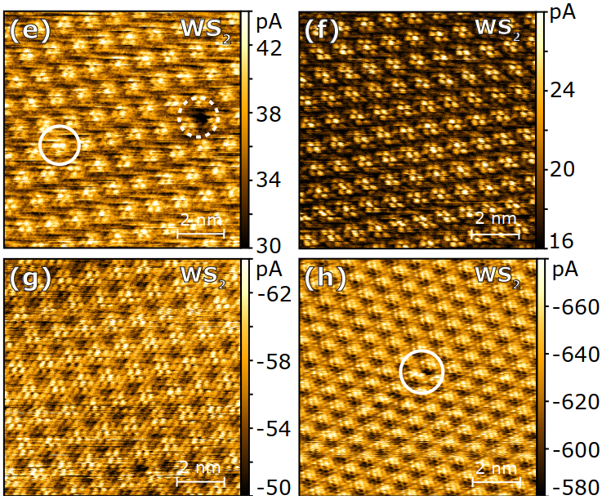
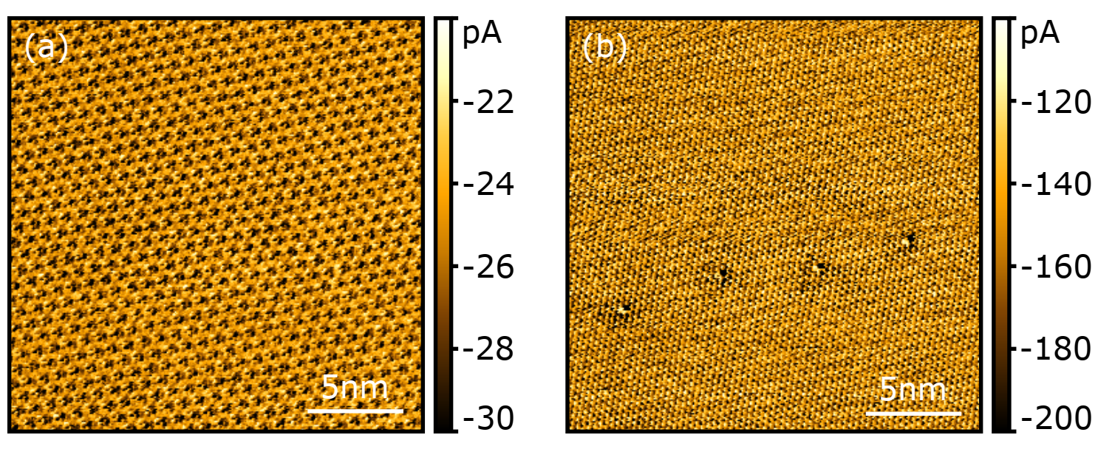
C(conductive)-AFM measurements of defects
(e) Augmenting (white circle) depleting defects(dashed white circle)
(f) 0.5 V and (g) -1 V sample bias in another region show only Moiré pattern
(h) This defect appears to change lattice site during scanning (top-to-bottom), showing a ‘slice’ effect where the defect switches from a dark to a bright feature. That may be a surface adsorbate.
(hard to identify such defects against the background of the Moiré pattern)
Initially, at bias voltage of -0.4 V (a), the defects cannot be seen, then when the bias voltage is increased to -0.8 V (b) they can be made out.
Notes:
charged defect is asymmetry between negative and positive bias, at positive bias a negatively charged defect should be observed as a dark feature
In the traditional view of a semiconductor, the gap is occupied only by defect states. However, current flows even when the tip is not interacting with a defect and the bias voltage is insufficient for carriers to enter the valence or conduction bands. It is likely that this current signal originates from the states in the HOPG substrate

